Slide 1


Introduction to Dart: A Developer's Overview
Welcome to our presentation on Dart, Google's versatile language. It's built for modern app development. Dart excels across platforms. It powers the popular Flutter UI framework. Prepare to explore its core features and benefits.
by Makeskilled Team

Slide 2

Dart Basic Structure: Your First Steps
Entry Point
Every Dart program starts with void main().
Statement Endings
Each statement must end with a semicolon.
Code Blocks
Curly braces define code blocks. This organises your logic.
Understanding these fundamentals is key. They form the backbone of all Dart applications. It's a clean, readable syntax.

Slide 3
Variables in Dart: Flexible Data Storage
Dart's flexible variable declaration suits different needs. camelCase is the standard naming convention. This ensures code readability and consistency.
Declaration
var uses type inference. Explicit types are also supported.
Choosing the right declaration improves performance. It also enhances maintainability. Always consider variable scope.
Immutability
final and const declare immutable variables. Use them for fixed values.

Slide 4
Datatypes in Dart: Ensuring Type Safety
Core Types
Dart's robust type system ensures reliable code. Understanding each datatype is crucial. It supports strong, predictable programming.
Includes int, double, String, bool, List, Map.
Type Safety
These types are fundamental building blocks. They help you structure complex data. Always leverage them for clarity.
Dart provides static type checking. This prevents common errors.
Null Safety
Null safety is enabled by default. This avoids null reference issues.

Slide 5





Operators in Dart: Logic and Computation
Arithmetic
Perform basic calculations: +, -, *, /, ~/.
Comparison
Evaluate relationships: ==, !=, >, <, >=, <=.
Logical
Combine conditions: &&, ||, !.
Assignment
Assign values: =, +=, -=.
Null-Aware
Handle nulls safely: ??, ??=, ?..
Dart offers a comprehensive set of operators. They enable diverse programming tasks. Master them for efficient code.

Slide 6
Conditional Statements: Controlling Flow
Conditional statements are vital for dynamic applications. They dictate program behaviour. Choose the best structure for clarity.
If-Else Logic
Use if, else if, else for decision-making.
These constructs ensure your app responds intelligently. They adapt to varying inputs. Practice using them effectively.
Switch-Case
Handle multiple conditions with switch-case statements.
Ternary Operator
Concise conditional assignments: condition ? expr1 : expr2.

Slide 7






Loops in Dart: Efficient Iteration
Collection Iteration
for-in simplifies iterating over collections.
Basic Loops
for, while, and do-while are standard.
Loop Control
break exits loops; continue skips iterations.
Loops are fundamental for repetitive tasks. They streamline data processing. Select the appropriate loop type for efficiency.

Slide 8

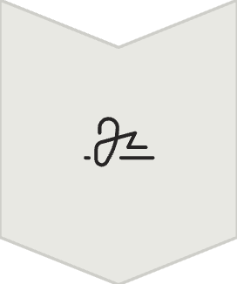
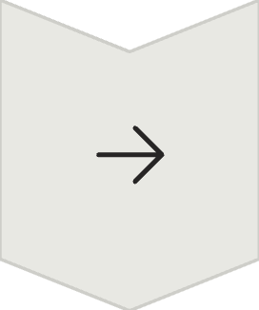
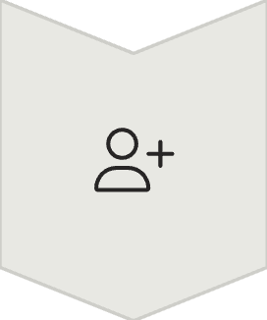

Functions in Dart: Modular Code
Definition
Define with returnType functionName().
Arrow Syntax
Concise functions use () => expr.
Parameters
Support optional and named parameters.
Anonymous Functions
Also known as lambdas, for inline use.
Functions promote code reusability. They enhance maintainability and readability. Master them for organised development.

Slide 9





Classes and Objects: Object-Oriented Dart
Class Keyword
1
Use "class" to define a class.
Constructors
2
Create objects using constructors.
Members
3
Define fields, methods, getters, setters.
Private
4
Underscore prefix makes members private.
Static
5
Static variables and methods supported.
Dart's object-oriented features enable powerful designs. They structure complex applications. Embrace them for scalability.

Slide 10
Additional Dart Syntax Essentials
Comments
// for single-line, /* */ for multi-line.
String Interpolation
Embed variables: "Hello, $name".
Collection Literals
Easy lists [] and maps {}.
Enums
Define fixed sets of values.
Imports
Use import for modular code.
These elements enhance Dart's expressiveness. They make code cleaner and more efficient. Incorporate them into your practice.

